Slide 1


GitHub
GitHub is an online software development platform. It's used for storing, tracking, and collaborating on software projects.
It makes it easy for developers to share code files and collaborate with fellow developers on open-source projects.
Creator Last Name, Year Published, Photograph Title, URL.

Slide 2
Objectives
* Version control
* Collaboration
* Code Hosting
* Issue Tracking
* Pull Requests
* Education
* Continuous Integration and Deployment(CI/CD)
* Documentation
* Community and Social Coding
* Code Reviews
* Project Management
* Security

Slide 3
Basic concepts
Repositiry
Clone
The collection of files and version history of those files is called a Repository.
To clone a repository is to create a local copy on the computer that is synchronized with the repository in GitHub.

Slide 4
Basic concepts
Commit
Branch
Pull Request
Commit: A commit is a snapshot of changes made to the code. It is a way to save your work within the version control system.
Branch is a parallel version of a repository. It allows you to work on different features or bug fixes independently.
A pull request is a way to propose changes to a repository. It notifies others that you've made changes and allows them to review and merge your code.

Slide 5
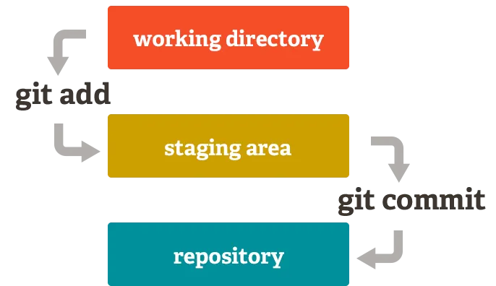
Four areas of GitHub

